Slide 1
Cultural and Multinational Management

Slide 2
Learning Objectives (1 of 2)
Define culture and understand the basic components of culture.
Identify instances of cultural stereotyping and ethnocentrism.
Understand how various levels of culture influence multinational operations.

Slide 3
Learning Objectives (2 of 2)
Apply the Hofstede, GLOBE, and 7d models to diagnose and understand the impact of cultural differences on management processes.
Appreciate the complex differences among cultures and use these differences to build better organizations.
Recognize the complexity of understanding new cultures and the dangers of stereotyping and cultural paradoxes.

Slide 4
What is Culture? (1 of 2)
Pervasive and shared beliefs, norms, values, and symbols that guide the everyday life of a group.
Cultural norms: both prescribe and proscribe behaviors
  What we can and cannot do.
Cultural values: what is good, what is beautiful, what is holy, and what are legitimate goals for life.

Slide 5
What is Culture? (2 of 2)
Cultural beliefs: represent our understandings about what is true.
Cultural symbols, stories, and rituals: communicate the norms, values, and beliefs of a society or a group to its members.
Culture is pervasive in society: affects all aspects of life.
Culture is shared: similarity in values, beliefs, norms.

Slide 6
Three Levels of Culture (1 of 2)
National culture: the dominant culture within the political boundaries of the nation-state.
    But there may be subcultures within the national culture.
Business culture: norms, values, and beliefs that pertain to all aspects of doing business in a culture.
    Tells people the correct, acceptable ways to conduct business in a society.

Slide 7
Three Levels of Culture (2 of 2)
3. Occupational and organizational culture
  Occupational culture: the norms, values, beliefs, and expected ways of behaving for people in the same occupational group, regardless of employer.
  Organizational culture: the set of important understandings (often unstated) that members of an organization share.

Slide 8
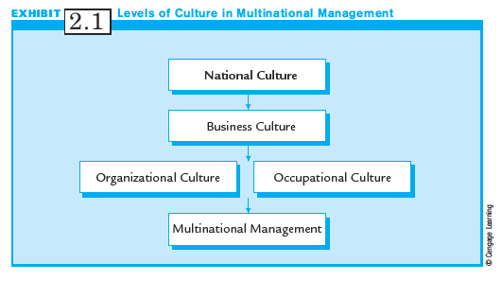
Exhibit 2.1:
Three Levels of Culture

Slide 9
Cultural Differences and
Basic Values
Three diagnostic models to aid the multinational manager:
  Hofstede model of national culture
  Global Leadership and Organizational Behavior Effectiveness (GLOBE) project
  7d culture model

Slide 10
Hofstede’s Model of
National Culture
Five dimensions of basic cultural values:
  Power distance
  Uncertainty avoidance
  Individualism
  Masculinity
  Long-term orientation

Slide 11
Hofstede’s Model Applied to Organizations and Management
(1 of 2)
Five management practices considered in the discussion of Hofstede’s model include:
1. Human resources management
    Management selection
    Training
    Evaluation and promotion
    Remuneration

Slide 12
Hofstede’s Model Applied to Organizations and Management
(2 of 2)
2. Leadership styles
  how leaders behave
3. Motivational assumptions
  beliefs re how people respond to work
4. Decision making and organizational design
  how managers make decisions and organize
5. Strategy
  effects of culture on selecting strategies

Slide 13
Power Distance (1 of 2)
Power distance concerns how cultures deal with inequality and focuses on:
  Norms that tell superiors (e.g., bosses) how much they can determine the behavior of their subordinates
  The belief that superiors and subordinates are fundamentally different kinds of people

Slide 14
Power Distance (2 of 2)
High power distance countries have norms, values, and beliefs such as:
  Inequality is fundamentally good.
  Everyone has a place: some are high, some are low.
  Most people should be dependent on a leader.
  The powerful are entitled to privileges.
  The powerful should not hide their power.

Slide 15
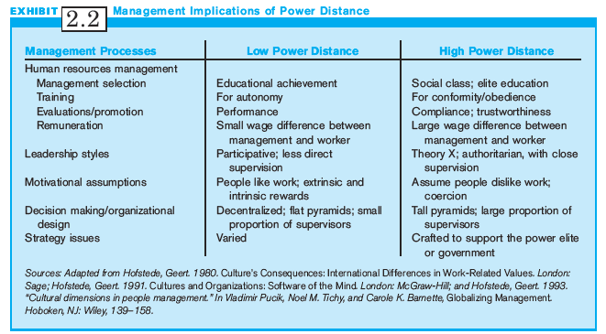
Exhibit 2.2:
Managerial Implications:
Power Distance

Slide 16
Uncertainty Avoidance
Uncertainty Avoidance: Norms, values, and beliefs regarding tolerance for ambiguity:
  Conflict should be avoided.
  Deviant people and ideas should not be tolerated.
  Laws are very important and should be followed.
  Experts and authorities are usually correct.
  Consensus is important.

Slide 17
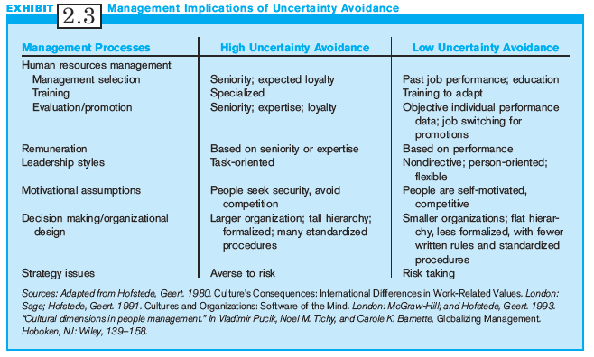
Exhibit 2.3:
Managerial Implications:
Uncertainty Avoidance

Slide 18
Individualism
Individualism: Focus is on the relationship between the individual and the group.
Countries high on individualism have norms, values, and beliefs such as:
  People are responsible for themselves.
  Individual achievement is ideal.
  People need not be emotionally dependent on organizations or groups.

Slide 19
Collectivism
Collectivism: Collectivist countries have norms, values, and beliefs such as:
  One’s identity is based on group membership.
  Group decision making is best.
  Groups protect individuals in exchange for their loyalty to the group.

Slide 20
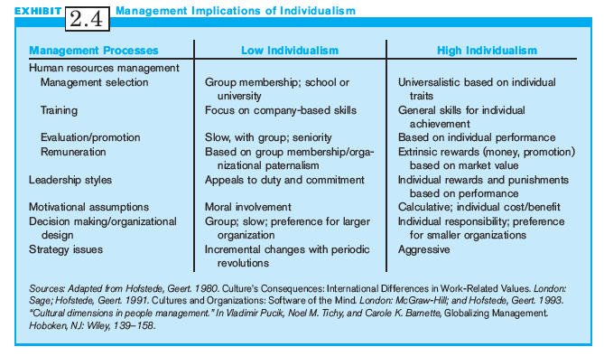
Exhibit 2.4:
Managerial Implications:
Individualism/Collectivism

Slide 21
Masculinity
Masculinity: Tendency of a culture to support traditional masculine orientation.
High masculinity countries have beliefs such as:
  Gender roles should be clearly distinguished.
  Men are assertive and dominant.
  Machismo or exaggerated maleness in men is good.
  People – especially men - should be decisive.
  Work takes priority over other duties, such as family.
  Advancement, success, and money are important.

Slide 22
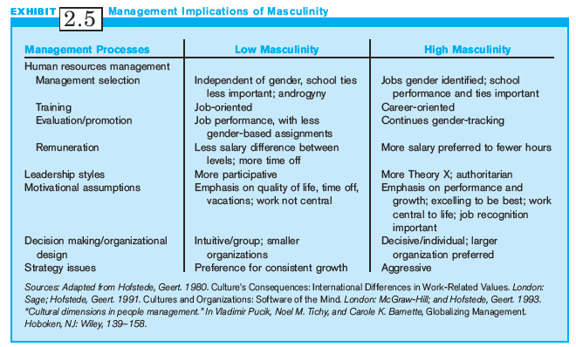
Exhibit 2.5:
Managerial Implications:
Masculinity

Slide 23
Long-Term
(Confucian) Orientation (1 of 2)
Long-Term Orientation: Orientation towards time that values patience.
  Managers are selected based on the fit of their personal and educational characteristics.
  A prospective employee’s particular skills have less importance in the hiring decision.
  Training and socialization for a long-term commitment to the organization compensate for any initial weaknesses in work-related skills.

Slide 24
Long-Term
(Confucian) Orientation (2 of 2)
Eastern cultures rank highest on long-term orientation.
Value synthesis in organizational decisions rather than search for correct answer.
Designed to manage internal social relationships.
Investment in long-term employment skills.
Focus on long-term individual and company goals.

Slide 25
Short-term Orientation
Short-Term Orientation: focus is on immediately usable skills
Western cultures, which tend to have short-term orientations, value logical analysis in their approach to organizational decisions.
Designed and managed purposefully to respond to immediate pressures from the environment.
Want immediate financial returns.

Slide 26
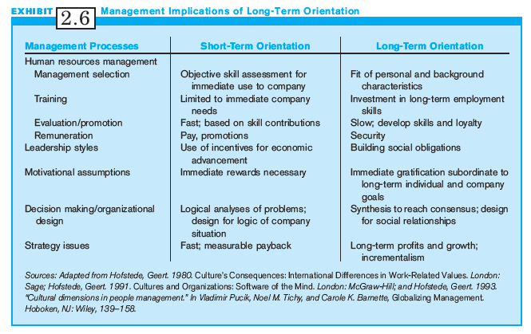
Exhibit 2.6:
Managerial Implications
Long-term Orientation

Slide 27
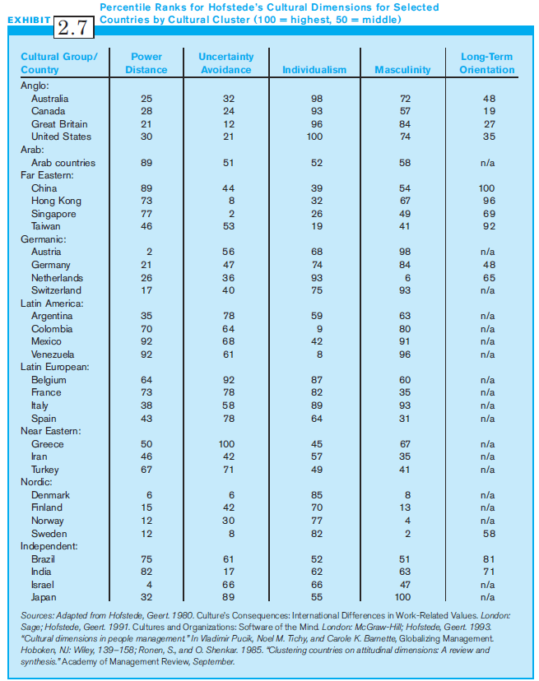
Exhibit 2.7:
Percentile Ranks for
Hofstede’s Cultural Dimensions

Slide 28
GLOBE National Culture Framework
GLOBE (Global Leadership and Organizational Behavior Studies) involves 170 researchers who collected data from 17,000 managers in 62 countries
7 of 9 dimensions of GLOBE are similar to Hofstede
GLOBE’s 2 Unique dimensions:
  Performance orientation
  Humane orientation

Slide 29
Performance Orientation
Performance Orientation refers to the degree to which the society encourages societal members to innovate, to improve their performance, and to strive for excellence.
  E.g., the United States and Singapore have high scores while Russia and Greece have low scores on the dimension.

Slide 30
Humane Orientation
Humane Orientation is an indication of the extent to which individuals are expected to be fair, altruistic, caring, and generous.
  Need for belongingness and affiliation is emphasized more than material possessions, self-fulfillment, and pleasure.
  Less humane-oriented societies are more likely to value self-interest and self-gratification.
  Malaysia and Egypt have high humane orientation scores, while France and Germany have low scores.

Slide 31
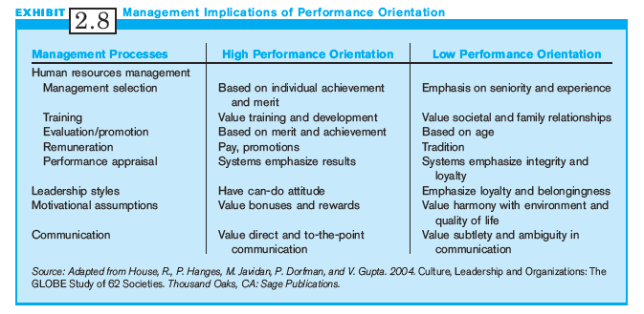
Exhibit 2.8:
Managerial Implications:
Performance Orientation

Slide 32
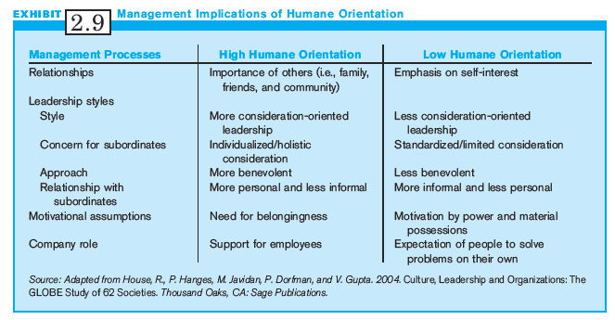
Exhibit 2.9:
Managerial Implications:
Humane Orientation

Slide 33
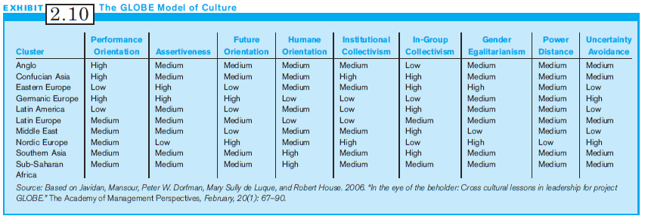
Exhibit 2.10:
GLOBE Model of Culture

Slide 34
7d Cultural Dimensions Model
(1 of 3)
Builds on traditional anthropological approaches to understanding culture.
Culture exists because people need to solve basic problems of survival.
Challenges include:
  How people relate to others
  How people relate to time
  How people relate to their environment

Slide 35
7d Cultural Dimensions Model
(2 of 3)
5 of the 7 dimensions of this model deal with relationships among people:
  Universalism vs. Particularism
  Collectivism vs. Individualism
  Neutral vs. Affective
  Diffuse vs. Specific
  Achievement vs. Ascription

Slide 36
7d Cultural Dimensions Model
(3 of 3)
The 2 remaining dimensions deal with how a culture manages time and how it deals with nature:
  Time: Past, Present, Future, or Mixture
  Nature: Control of vs. Accommodation with Nature

Slide 37
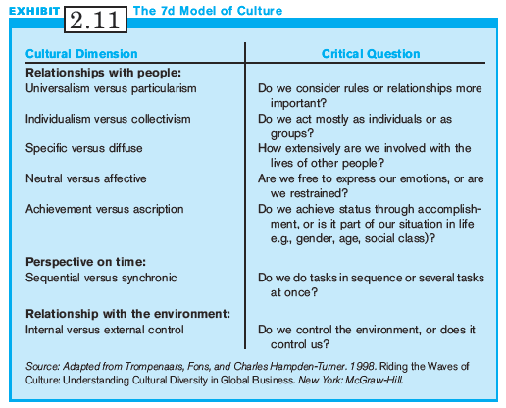
Exhibit 2.11:
The 7d Model of Culture

Slide 38
Universalism vs. Particularism
These concepts pertain to how people treat each other:
Universalism:
  Based on abstract principles such as rules of law, religion, or cultural principles.
Particularism:
  Rules are only a rough guide. Each judgment represents a unique situation, which must take into account who the person is, and his relationship to the one making the judgment.

Slide 39
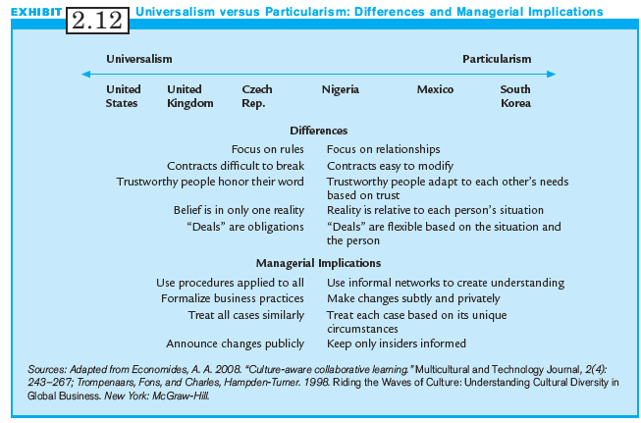
Exhibit 2.12:
Managerial Implications: Universalism/Particularism

Slide 40
Individualism vs. Collectivism
Similar distinctions to Hofstede’s view
Collectivist societies:
  Focus on relationships.
  “Deals” are flexible, based on situation and person.
  Contracts are easy to modify.
Individualist societies:
  Focus on rules.
  “Deals” are obligations.
  Contracts are difficult to break.

Slide 41
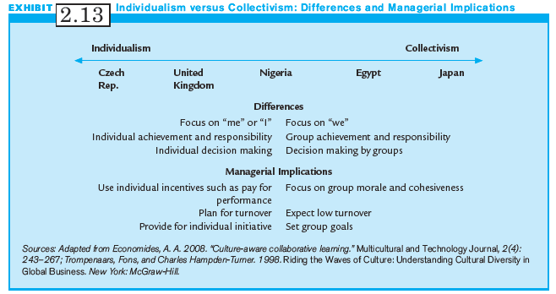
Exhibit 2.13:
Managerial Implications:
Individualism/Collectivism

Slide 42
Neutral vs. Affective
Concerns the acceptability of expressing emotions.
Neutral:
  Interactions should be objective and detached.
  Focus is more on tasks rather than emotional nature of interaction.
Affective:
  Emotions are appropriate in almost all situations.
  Preferred to find immediate outlet for emotions.

Slide 43
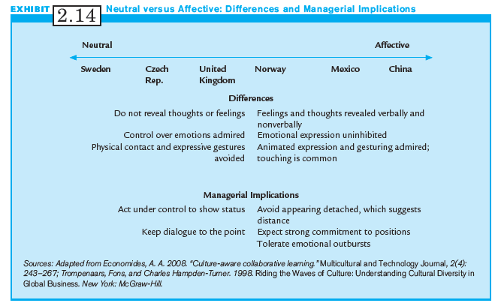
Exhibit 2.14:
Managerial Implications:
Neutral vs. Affective

Slide 44
Specific vs. Diffuse
Addresses the extent to which an individual’s life is involved in work relationships
Specific:
  Business is segregated from other parts of life
  Contracts often prescribe and delineate relationships
Diffuse:
  Business relationships encompassing and inclusive
  Prefer to involve multiple life areas simultaneously.

Slide 45
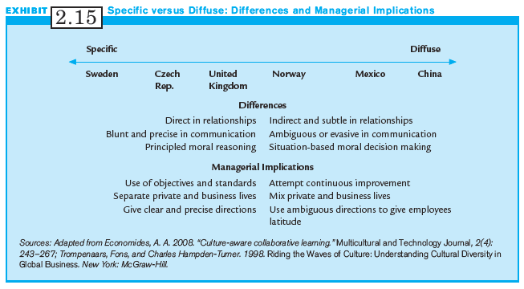
Exhibit 2.15:
Managerial Implications:
Specific vs. Diffuse

Slide 46
Achievement vs. Ascription
Addresses the manner in which society accords status
Achievement:
  People earn status based on performance and accomplishments
Ascription:
  Characteristics or associations define status
  E.g., status based on schools or universities

Slide 47
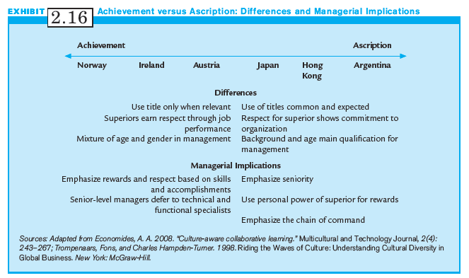
Exhibit 2.16:
Managerial Implications:
Achievement vs. Ascription

Slide 48
Time Orientation
Time Horizon: How cultures deal with the past, present and future
  Future-oriented societies, such as the U.S., consider organizational change as necessary and beneficial.
  Believe a static organization is a dying organization.
  Past-oriented societies assume that life is predetermined based on traditions or will of God.
  Revere stability and are suspicious of change.

Slide 49
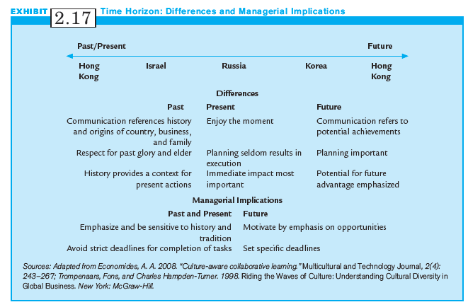
Exhibit 2.17:
Managerial Implications:
Time Horizon

Slide 50
Internal vs. External Control
Concerned with beliefs regarding control of one’s fate
Best reflected with how people interact with the environment
  Does nature dominate us or do we dominate nature?
In societies where people dominate nature, managers are more proactive and believe situations can be changed.

Slide 51
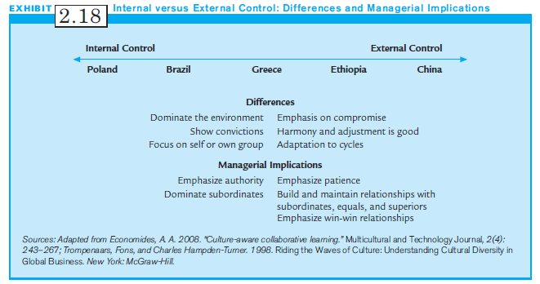
Exhibit 2.18:
Managerial Implications:
Internal vs. External Control

Slide 52
Caveats and Cautions
Stereotyping: assumes that all people within one culture behave, believe, feel, and act the same.
Ethnocentrism: occurs when people from one culture believe that theirs are the only correct norms, values, and beliefs.
Cultural relativism: all cultures, no matter how different, are correct and moral for the people of those cultures.
Cultural Intelligence: ability to interact effectively in multiple cultures

Slide 53
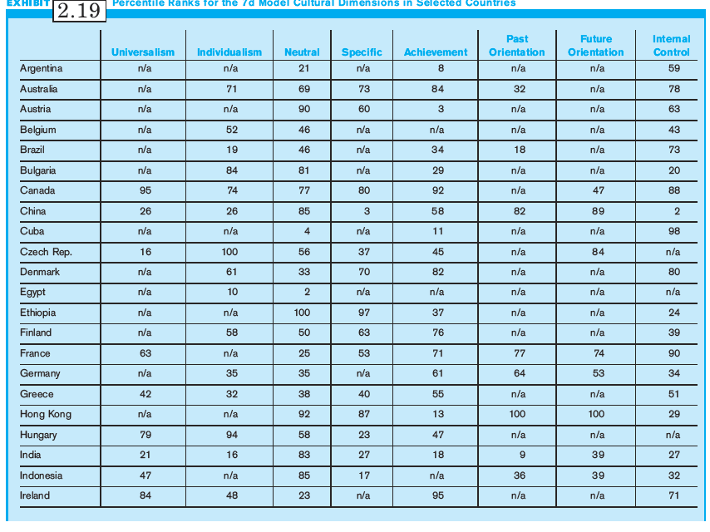
Exhibit 2.19:
Percentile Ranks for 7d Model (1 of 2)

Slide 54
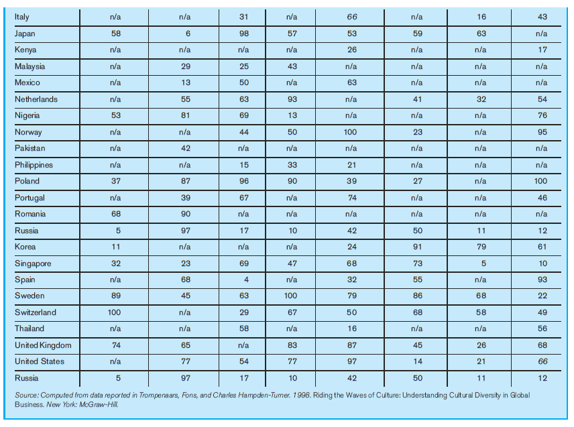
Exhibit 2.19:
Percentile Ranks for 7d Model (2 of 2)

Slide 55
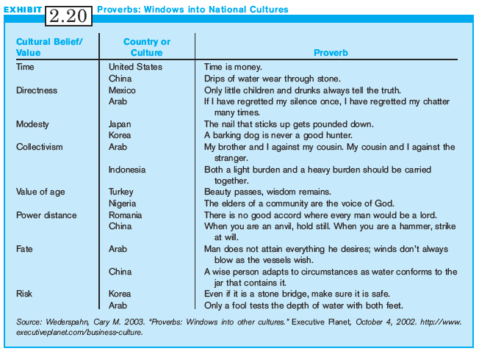
Exhibit 2.20:
Proverbs:
Windows into National Cultures

Slide 56
Summary
There are an immense variety of cultures in the world.
This chapter provides one approach to understanding national cultures.
Goal is to make one aware of complex and subtle influences of culture on multinational management.
Astute managers realize that understanding cultures is a never-ending learning process.

